Slide 1
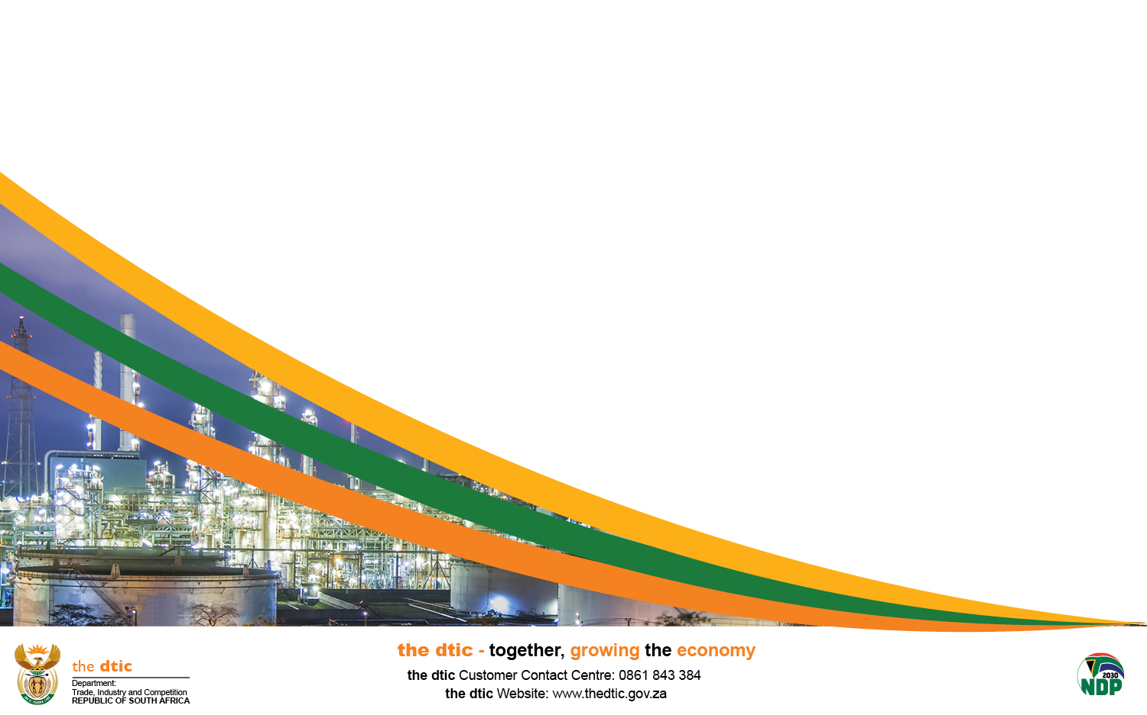
OVERVIEW OF THE INCENTIVES
  Incentives Branch - the dtic
  Lionel Archillies

Slide 2
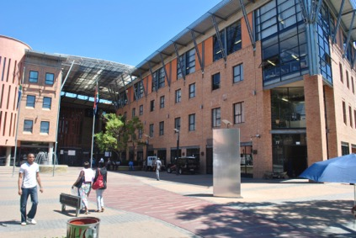
CONTENTS
  Industrial Financing Branch (IFB)
  Summary of Incentives
  The Application Process
  Contact Details

Slide 3
Contact Details
LIONEL ARCHILLIES
Deputy Director: Incentives Branch
Western Cape Province
021 480 8063
071 610 9558
LArchillies@thedtic.gov.za
E-mail: incentives@thedti.gov.za
Telephone: 012 394 1255
Customer Contact Centre: 0861 843 384
website: www.thedtic.gov.za (Financial Assistance)

Slide 4
Industrial Financing BRANCH (IFB)
THE PURPOSE of the IFD is to grow sustainable, competitive enterprises through accessible incentive measures that support national priorities.
OBJECTIVE 1
To support industrial development that will enhance productivity and bolster competitiveness through designing, administering, monitoring and evaluating the manufacturing incentives programme based on industrial policies and sector strategies developed by providing financial support in labour-intensive sectors on an ongoing basis.
OBJECTIVE 2
To contribute to the accelerated growth of the manufacturing and internationally traded services over the long term through the provision of incentives for industrial infrastructure development.

Slide 5
FINANCIAL INSTRUMENTS …
Almost 20 financial instruments (Schemes and sub-Schemes)
Incentives v/s Grants? Expected specific outcomes! Not repayable, no credit checks
Mainly support the productive/industrial sectors: Manufacturing and Agro-Processing, Not primary agriculture, not mining
Start-ups(?), Expansions, Upgradings,
The quality of business cases a determinant factor! Projects adjudicated on the basis of their feasibility:
Economical viability: Profitability
Technical viability: Capability to manufacture, produce
Cost Sharing: Co-funding essential - No 100% financial support
Reimbursement principle: No upfront payments
Main Qualifying Costs: Factory Buildings, Machinery, Tools and Equipment (including technologies, compliance, etc)
Working Capital: Selective application
Individual Schemes Rules: Compliance! Compliance! Compliance!
[1]

Slide 6
ECONOMIC DEVELOPMENTAL OBJECTIVES …
Criteria | Description
A. Employment | Securing/retaining or increasing direct employment
B. Market Share | New business/operations: Securing market share for the entity; OR Existing business/operations: Increase market share for the entity
C. Quality Improvement | Reduction of relative prices and/or increasing the quality of products to consumers
D. Green Technology and Resource Efficiency Improvements | Savings or better utilisation of energy or materials and/or cleaner production improvement and/or waste management improvement and/or water usage improvement and/or use of renewable energy
E. Localisation | Increasing the localisation of production activities (diversification and exports)
F. Regional Spread | Projects should be located in rural areas or areas with unemployment higher than twenty five percent (25%)
G. Personal Risk | Demonstrate own financial and/or non-financial contribution to the business
H. Empowerment | Achieve at least a level Four (4) B-BBEE contributor status as per revised B-BBEE codes of good practice published in October 2013 (as amended)
[1]

Slide 7






INCENTIVE CLUSTERS …
INNOVATION CLUSTER
MANUFACTURING INVESTMENT CLUSTER
SERVICES INVESTMENT CLUSTER
EXPORT PROMTION CLUSTER
INFRASTRUCTURE INVESTMENT CLUSTER
Technology and Human Resources for Industry Programme (THRIP)
Support Programme for Industrial Innovation (SPII)
Black Industrialists Scheme (BIS)
Aquaculture Development Incentive Programme (ADEP)
Strategic Partnerships Programme (SPP)
Agro-processing support scheme (APSS)
Automotive Investment Scheme (AIS)
MCEP Loan Facility (IDC)
Global Business Services Incentive (GBS)
SA Emerging Black Filmmakers
SA Film and TV Production
SA Film and TV Production & Co-Production
Foreign Film and TV Production & Post-Production
Export Marketing and Investment Assistance (EMIA)
Sector-Specific Assistance Scheme (SSAS)
Capital Projects Feasibility Programme (CPFP)
Special Economic Zones (SEZ)
Critical Infrastructure Programme (CIP)
Industrial Parks

Slide 8
APPLICATION PROCESS
APPLICATION PROCESS
Application:
  Applicant obtains incentive application form and guidelines from the dti website (www.thedtic.gov.za) under Financial Assistance tab;
  Applicant may obtain further information telephonically, by e-mail or visit to the dti offices.
  The guideline should be read before completing the application form.
  The Applicant e-mails the completed, signed application form with supporting documents to the dedicated email address;
  Basic Evaluation:
  The application is allocated to a processor for assessing its completeness
  The applicant will receive an acknowledgement letter from the Programme Administration;
  The review of the documents is undertaken and should all documents be in place, the application is sent for further processing and prepared for adjudication;
  If the application has outstanding documents, then the applicant is contacted and provided with a timeframe within which to provide the outstanding information
  Adjudication:
  Technical evaluation will be performed for the complete applications;
  Adjudication Committee convenes to assess the application - Applications are approved, rejected or referred back for additional information.
  The decision of the Adjudication Committee is final.
  Letter confirming approval of the application and the claim form will be forwarded to the applicant within a specified timeframe.

Slide 9
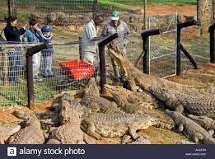
Incentive Programme | Purpose | Target / Eligibility Criteria | Incentive Offering
Aquaculture Development and Enhancement Programme (ADEP) | To stimulate investment by commercially viable enterprises in the aquaculture sector (freshwater and marine farming): Fish hatcheries, fish farms and crocodile farms Production, processing and preserving of aquaculture fish New, upgrading or expanding projects | South African Registered Entities engaged in the following operations: Primary Hatchery facilities : Brood Stock, Seed Production, Juvenile (spat, fry, fingerling) Nursery facilities and operations Grow out facilities and operations Secondary Post-harvest handling, eviscerating, packing & quick freezing Filleting, portioning, packaging and trading Value adding: curing, brining & smoking Waste stream handling Ancillary Feed manufacturing, Emerging Black farmers | Reimbursable cost-sharing grant of 30% - 50%, maximum of R20 million for qualifying costs: Machinery, equipment and tools Bulk infrastructure; Land (small enterprises) Buildings; Competitiveness improvement activities; Commercial vehicles and work boats. Mentorship (small enterprises) Score based on economic benefit criteria

Slide 10
ADEP – SMALL BLACK FARMERS
Definition – 100% black ownership,
Operational and management control over the business
Makes long-term commitment to the business
Medium to long term investor: below R5m
Black People – Africans, Chinese, Coloured and Indians who are natural persons and Citizens by birth or decent or naturalisation before 1993;
The dtic may allocate an additional 5% grant for small black enterprises based on the economic benefit criteria

Slide 11
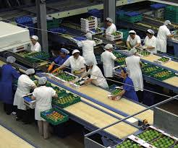

Incentive Programme | Purpose | Target / Eligibility Criteria | Incentive Offering
Agro-Processing Support Scheme (APSS) | To stimulate investment by SA agro-processing/beneficiation enterprises (agri-business) Investment to achieve some of the following: Increased Capacity Employment Creation Modernised Machinery & Equipment Competitiveness & productivity improvement Broadening Participation | South African Registered Entities in the following sub-sectors: Food & beverage value addition and processing (including Black winemakers) Furniture manufacturing Fibre processing Feed production; and Fertilizer production Essential Oil Production | Reimbursable cost-sharing grant of 20% to 30% to a max of R20 million for qualifying costs Buildings New machinery, equipment, tools, technologies; Commercial vehicles Competitiveness Improvement Costs

Slide 12


Incentive Programme | Purpose | Incentive Offering
Export Marketing Investment Assistance (EMIA) | Aims to support exporters to explore export markets | Individual Exhibition Participation | Return airfare Subsistence allowance Transportation of samples Exhibition costs
 |  | Primary Market Research(PMR) & Foreign Direct Investment (FDI) | Return airfare Subsistence allowance Transportation of samples Patents Production of marketing material
 |  | Individual Inward Missions | Return airfare Subsistence allowance Car rental
 |  | Group Missions & National Pavilions | Selected Trade Fairs & Exhibitions / Export Councils, Industry Associations & Provincial Trade Promotion Agencies Return airfare Subsistence allowance Transportation of samples Exhibition costs

Slide 13
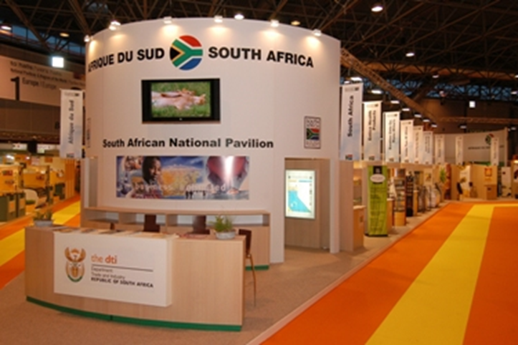
Incentive Programme | Purpose | Target / Eligibility Criteria | Incentive Offering
Sector Specific Assistance Scheme (SSAS) Components: Generic Funding (Administered by TISA) Project Funding (Administered by IFD) Project Funding for the Emerging Exporters (Administered by IFD) | A reimbursable cost-sharing incentive scheme whereby financial support is granted to organisations supporting the development of industry sectors and those contributing to the growth of South African exports. | Organisations supported under include: Export Councils, Joint Action Groups, Industry Associations and those organisations that are involved in the development of emerging exporters | SSAS/Project Funding - A reimbursable 80:20 cost-sharing grant scheme SSAS/Emerging Exporters -100% of the cost to a maximum of R1, 9 million per project

Slide 14
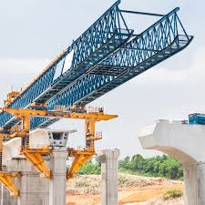
Incentive Programme | Purpose | Target / Eligibility Criteria & Incentive Offering
Critical Infrastructure Programme (CIP) | The programme aims to leverage investment by supporting infrastructure, agro-processing projects, state owned testing facilities, South African film and television studios and cinemas, state-owned industrial parks, strategic feasibility studies and projects that alleviate dependency on the national grid, water and sanitation networks deemed critical or of a strategic nature, thereby lowering the cost of doing business. | Registered private entities and local governments (municipalities, excluding metropolitan municipalities) Types of supported projects: capped at R50m STRATEGIC INFRASTRUCTURE FEASIBILITY STUDIES – 60:40 of total qualifying studies costs and 80:20 (inside SEZs) GENERIC INVESTMENT - 10% to 30% of total qualifying infrastructural development costs capped SA Film and TV Studios and Cinemas – 30:70 cost sharing for SA owned film & television studios and cinemas STATE OWNED TESTING FACILITES - 50:50 cost sharing of total qualifying infrastructural development costs STATE OWNED INDUSTRIAL PARKS: 100% of total qualifying infrastructural development costs DISTRESSED MUNICIPALITIES or INVESTORS IN SUCH MUNICIPALITIES: 15-100% of total qualifying infrastructural development costs up to R50m; 100% support towards strategic infrastructure studies, capped at R10m

Slide 15
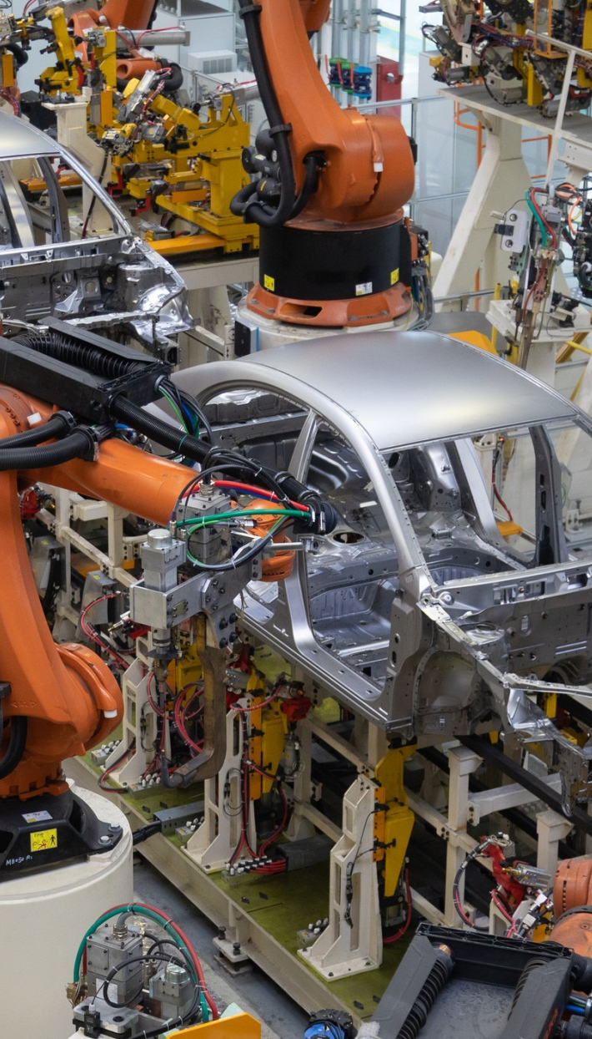




Thank you

