Slide 1
SMALL ENTERPRISE DEVELOPMENT AGENCY
DATE: 17 May 2024
EVENT: SMME Conference and Expo
NAME OF PRESENTER : Denise van den Berg

Slide 2
CONTENT
Vision and mission
Enterprise Support Network
Target market
Products and services
How do we give support?
PRESENTATION OVERVIEW 2

Slide 3
VISION AND MISSION
OUR VISON
To be the centre of excellence for small enterprise development in South Africa.
OUR MISSION
To develop, support and promote small enterprises to ensure their growth and sustainability in coordination with other role players.
OUR GOALS
To ensure that the small enterprise sector grows and increase its contribution to sustainable and equitable social and economic development, employment and wealth creation.

Slide 4
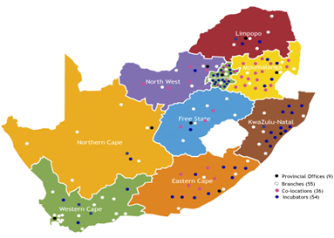
ENTERPRISE SUPPORT NETWORK
Business
Talk
Assess
Advise
Train
Register
Business
Start
Market Plan
Counselling
Finance
Support
Business
Build
Capacitate
Mentor
Procure
Franchising
Business
Grow
Growth Support
Export Readiness
Manuf. Support
Supplier Dev.
57+ Seda Technology and TVET Incubators
(STP)
Incubation for Start-Ups
Assessment, Selection
Training, Systems, Tools
Offices, Workshops
Shared Business Processes
Market & Finance Plans
Mentoring, Tracking

Slide 5
WESTERN CAPE OFFICES
National Office – Pretoria
9 Provincial Offices
Operational Branches
Western Cape
Cape Winelands District
Cape Winelands Branch
Worcester Branch
Overberg District
Hermanus Branch
Swellendam Branch
West Coast District
Vredenberg Branch
Cape Town Metro pole
Cape Town Branch (Bellville)
Cape Town CBD Branch
Atlantis Branch
Khayelitsha Branch
Eden District
Eden Branch
Knysna Branch
Mosselbay Branch
Oudshoorn Branch
Central Karoo District
Beaufort West
PRESENTATION OVERVIEW 2

Slide 6
TARGET MARKET

Slide 7
SEDA OFFERINGS
Seda Business Talk
Business Advice and Information
Small Business Training
Business Registration

Slide 8
SEDA OFFERINGS
Seda Business Start
Business Planning
Business Counselling
Facilitation of Access to Finance
Business Support

Slide 9
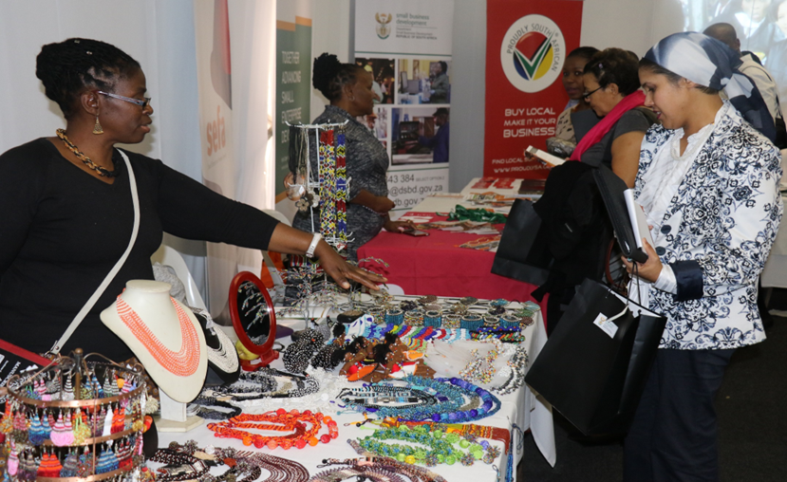
SEDA OFFERINGS
Seda Business Build
Capacity Building Systems
Mentorship
Tender Advice/Procurement
Export Readiness
Franchising

Slide 10
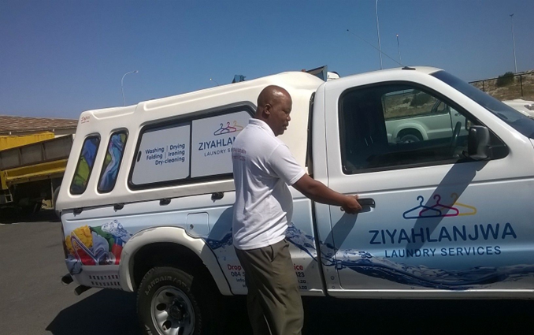
SEDA OFFERINGS
Seda Business Grow
Business System Support
Cooperative Support
Growth Strategies

Slide 11
SEDA PRODUCTS AND SERVICES
Programme | Description
Export Development Programme | This is a programme whereby small enterprises are assessed with regards to their export readiness and then supported with a number of relevant interventions to ensure that they become export ready. Once it is determined that they are export ready they are provided with opportunities to market their products locally and internationally through trade shows and other platforms.
Manufacturing Support Programme | This is a programme designed to assist small and micro manufacturers, the support includes technical and generic training, Quality Systems implementation as well as assistance to acquire necessary machinery and equipment to support their growth.
Supplier Development Programme | The supplier development programme is a framework whereby Seda supports corporates and private sector companies to implement supplier development programmes. The objective is to ensure that the supplier development initiatives implemented are value adding, aligned to best practice and to ensure that SMME’s are provided with market access opportunities.
Coaching Programme | The Seda Enterprise Coaching Programme is a programme based on international best practice. It is a ten-month programme focused on growing small businesses. The programme focuses on providing a set of generic business skills, individual entrepreneur coaching as well as establishing peer to peer mentorship networks.
Mentorship Programme | This programmes focuses on linking small enterprises and entrepreneurs with a skilled and experienced mentor to assist the business to grow, impart knowledge and experience and unlock various market opportunities.
Business management training | This intervention is focused on providing aspiring and existing small business owners with business management training, to enable their business to be sustainable and grow.

Slide 12
SEDA PRODUCTS AND SERVICES
Programme | Description
Cooperatives and Community Public Private Partnerships | Seda support co-operatives on principles of co-operation, how to manage a co-operative. Training co-operatives on the Co-operatives Act, and on how to go about forming a co-operative. Further support includes business management training and providing cooperatives with business development interventions.
Basic Entrepreneurial skills Development | The programme is designed to transfer of basic business skills to micro-business owners during weekly two-hour one-on-one training/coaching sessions at their business premises over approximately 15 months.
Quality & Standards | The programme entails management systems development that ensures that the enterprises become resilient and operate efficiently. Product Testing /Certification ensures that the products manufactured by the entrepreneurs are safe and meet the statutory and regulatory requirement.
Technology Transfer Programme | Support to acquire innovative, production-enhancing technology, to assist small and micro enterprises to grow, and propel them to start competing in the mainstream economy.
Incubation Programme | Technology Business Incubation is a 3-year programme designed to strengthen technology commercialisation and harness the entrepreneurship of the technology community in South Africa. Other support include nurturing small businesses and start-ups in a controlled environment where they are mentored by experiences business development specialist until they are able to operate on their own.

Slide 13
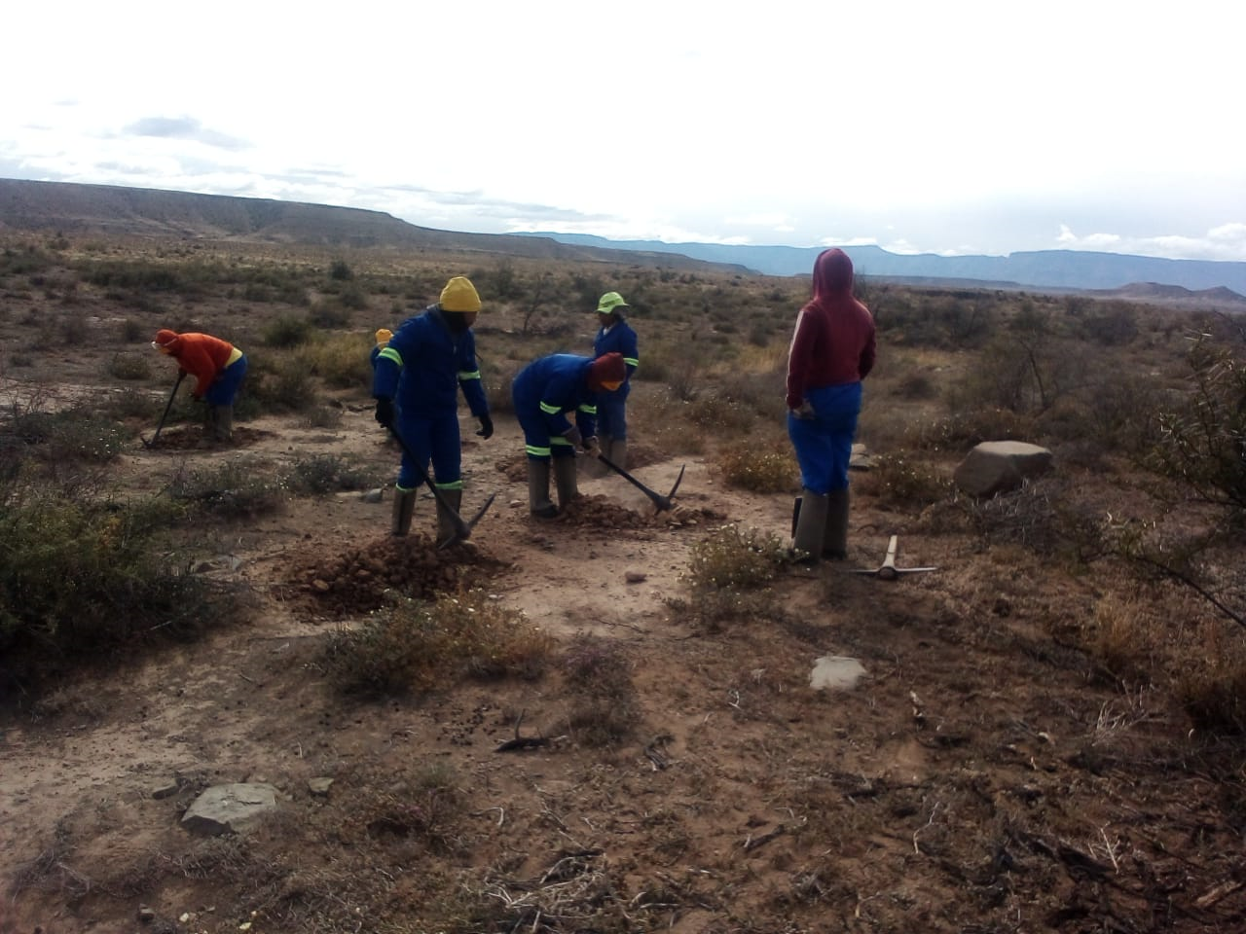
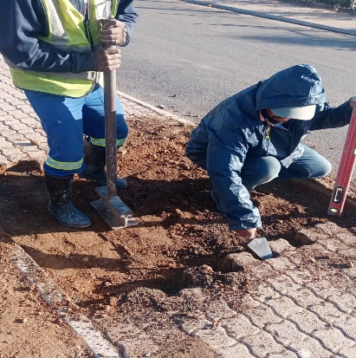
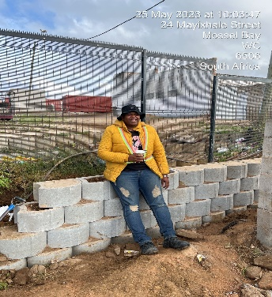
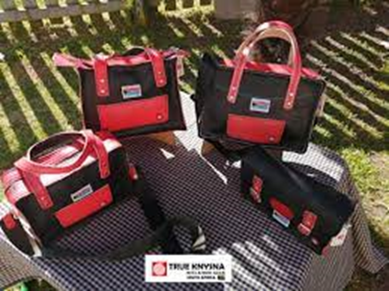
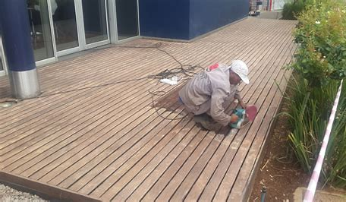
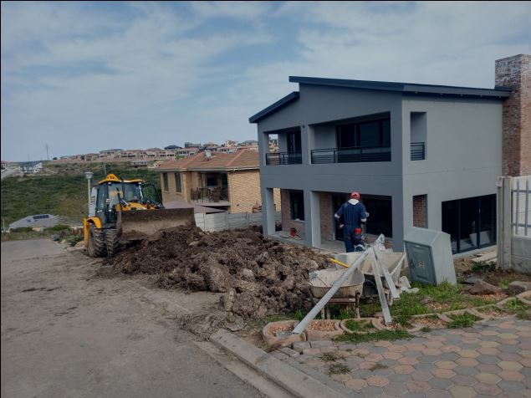
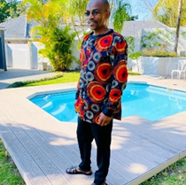
Seda CLIENTS
PRESENTATION OVERVIEW 2

Slide 14
HOW DO WE GIVE SUPPORT?
Filter Process:
Referral from Stakeholder
Invite to Information Session
Assign to Seda Business Advisor
Register as a client on Seda online platform: https://seda.kasune.io/
Diagnostic Assessment and recommendations/action plan
Client, Business Advisor and Branch Manager signs the assessment
Intervention – initiated
Use service providers registered on our database
Our subsidy is up to 90%
Turnaround time depends – client, Business Advisor, Branch Manager and Service Provider

Slide 15
CURRENT OPPORTUNITIES
Bizportal – www. bizportal.gov.za
CIPC (Companies Intellectual Property Commission – www.cipc.co.za
SARS (South African Revenue Service) – www.sars.co.za
National Treasury - https://secure.csd.gov.za
(NYDA) National Youth Development Agency – www.nyda.org.za
Department of Labour – UIF & COIDA – www.labour.gov.za

Slide 16
CURRENT REFERRAL OPPORTUNITIES CONT
Wesgro – www.wesgro.co.za
e-centres – www.westerncape.gov.za/capeaccess/e-centres
Jump for Entrepreneurs – www.bizjump.co.za
Labour Advice Web Tool for Small Business – www.smelaboursupport.org.za
Department of Economic Development & Tourism (DEDAT) Government Tenders www.gov.za
Cape Nature - www.capenature.co.za

Slide 17
FUNDING OPPORTUNITIES CONT
Finfind – www.finfind.co.za
Sefa (Small Enterprise Funding Agency) – www.sefa.org.za
DTI Funding – www.thedtic.gov.za
National Empowerment Fund (NEFCORP) – www.nefcorp.cp.za
Industrial Development Corporation (IDC) – www.idc.co.za
Commercial Banks Business Loans (ABSA, Nedbank, Standard Bank, FNB)
Isivande Women’s Fund (IWF) - www.fundingconnection.co.za
Business Partners - www.businesspartners.co.za
LulaLend - www.lulalend.co.za
Cape Agency for Sustainable Integrated Development in Rural Areas (Casidra) –www.casidra.co.za
Various District Municipalities – Seed Funding

Slide 18
SEDA CONTACT DETAILS
Eden: 044 803 4900
Quinton Coetzee – qcoetzee@seda.org.za
Denise van den Berg - Dvandenberg@seda.org.za
Beaufort West 023 414 3368/2970
Knysna 044 382 2861
Mossel Bay 044 695 0418/0497
Oudtshoorn 044 272 7783
George 044 803 4900
THANK YOU

